Slide 1


Slide 2

BMC – Business Model Canvas
Prof. Ms. Gabriela Salomão
2024

Slide 3
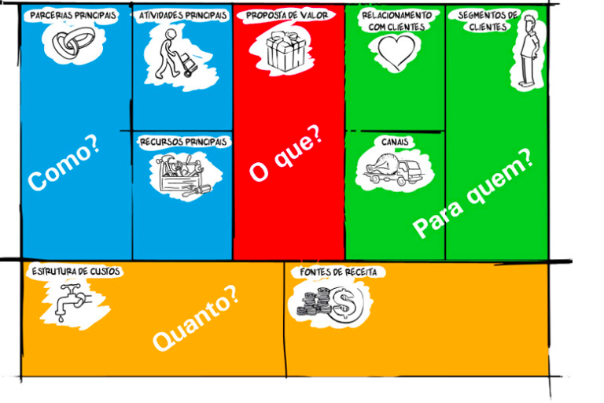

Slide 4
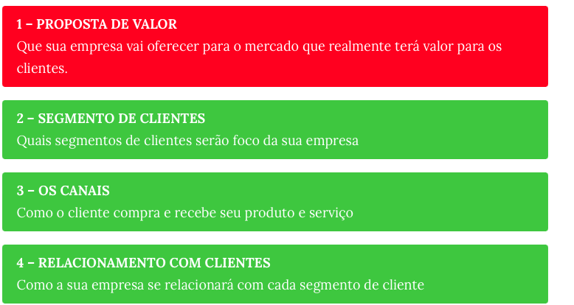

Slide 5
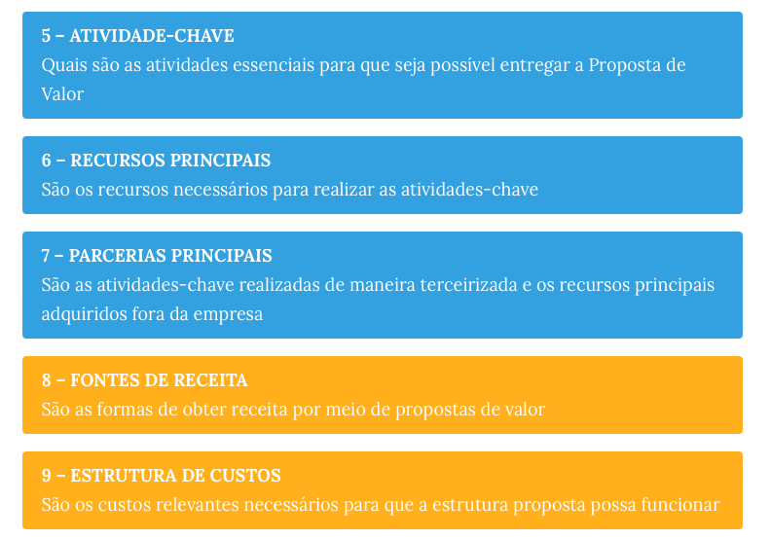

Slide 6
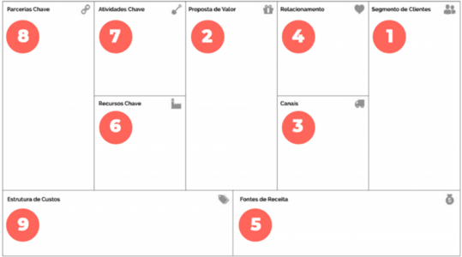

Slide 7
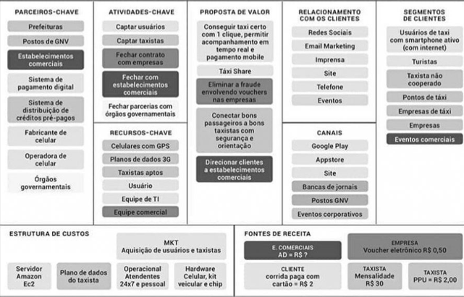
Exemplo:

Slide 8
Bora praticar?
https://miro.com/app/board/o9J_lBEGM_k=/

Slide 9



